Slide 1
Does Policy Uncertainty Affect Mergers and Acquisitions?
Alice Bonaime University of Arizona
Huseyin Gulen Purdue University
Philip E. Strahan University of Arizona
Presented by Austin Francis

Slide 2
Research Question
Does policy uncertainty negatively affect merger and acquisition (M&A) activity at the macro and firm levels?

Slide 3
Prior Literature
Determinants of M&A Activity: Prior studies identify key factors influencing mergers, such as bidder/target valuations, business cycles, industry shocks, and corporate liquidity. M&A activity is also influenced by CEO traits, risk management, and market conditions (Shleifer & Vishny, 2003; Garfinkel & Hankins, 2011).
Policy Uncertainty and Economic Outcomes: Research shows that policy uncertainty increases stock price volatility, reduces industrial production, and impacts foreign direct investment (Baker et al., 2016; Julio & Yook, 2016). Policy uncertainty is also linked to lower capital expenditures and decreased equity issuance (Colak et al., 2016).

Slide 4
Prior Literature
Uncertainty and M&A Activity: Previous studies find that policy-related uncertainty, particularly macroeconomic shocks, deters M&A activity. Real options theory suggests that uncertainty increases the incentive to delay acquisitions, with stronger effects on public targets and large deals (Bhagwat et al., 2016).

Slide 5
Hypothesis
Policy uncertainty has a strong negative effect on M&A activity by increasing the value of the option to delay investments, especially in irreversible deals or those sensitive to policy uncertainty.

Slide 6
Key Metrics
Baker, Bloom, and Davis (BBD) Policy Uncertainty Index
Aggregate M&A deal value and volume
Acquisition likelihood at the firm level
Real options, deal premiums, termination fees, and MAC clauses in M&A contracts

Slide 7
Key Metrics – Policy Uncertainty
News Component: Automated searches in ten major U.S. newspapers count articles containing keywords like "uncertainty," "economic," "congress," and "Federal Reserve." The count is scaled by the total number of articles for each month, and then normalized to have a unit standard deviation. This news-based component is weighted at 50% in the overall index.
Tax Component: Based on Congressional Budget Office data, this component estimates the discounted value of revenue effects from tax provisions set to expire within the next ten years. This component is weighted at 16.7% in the overall index.
Monetary and Fiscal Forecasts: These components capture forecaster disagreement regarding future monetary and fiscal policies, using the interquartile range of forecasts from the Survey of Professional Forecasters. The two components—one for CPI forecasts and one for government spending forecasts—are each weighted at 16.7%.
Notes:
The overall index is a weighted average of these components and is scaled to have a mean of 100 from 1985 to 2009.

Slide 8
Results
Negative Impact of Policy Uncertainty: A one standard deviation increase in policy uncertainty reduces M&A deal value by 6.6% and the number of deals by 3.9%.
Firm-Level Effect: Policy uncertainty lowers the likelihood of a firm announcing a merger by 1.1 percentage points, or 8.9% of the unconditional probability.

Slide 9
Data Collection
Baker et al. (2016) Policy Uncertainty Index
Securities Data Company (SDC) for M&A data
CRSP and Compustat for firm-level data
Additional macroeconomic variables from various sources like the Bureau of Economic Analysis (BEA), St. Louis Federal Reserve, and University of Michigan.

Slide 10
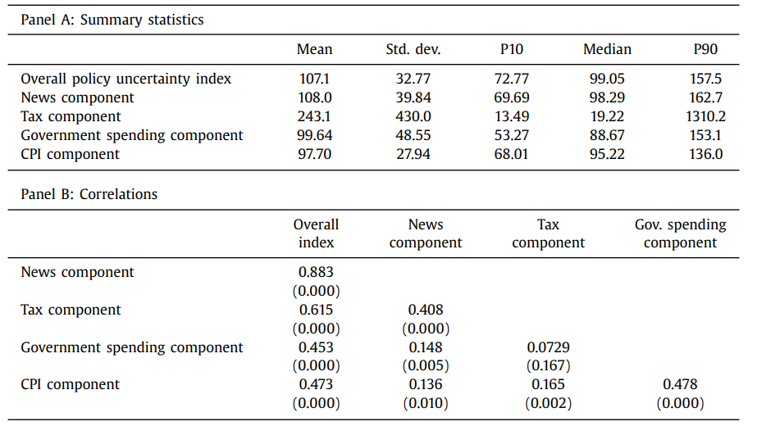
Table 1
Notes:
SUMMARY STATS Table 1: Policy Uncertainty Index and Components
The overall policy uncertainty index has a mean of 107.1 with significant volatility (standard deviation of 32.77).
The correlation between the news and overall index is 0.883, indicating a strong relationship between media coverage and policy uncertainty.

Slide 11
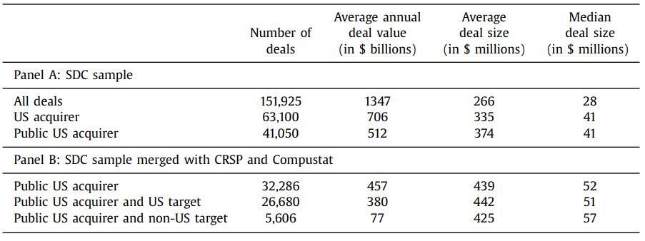
Table 2
Notes:
SUMMARY STATS
Table 2: Merger and Acquisition Summary Statistics The sample includes 151,925 M&A deals with a mean deal size of $266 million and a median deal size of $28 million. Public U.S. acquirers accounted for 41,050 deals, with an average deal size of $374 million.

Slide 12
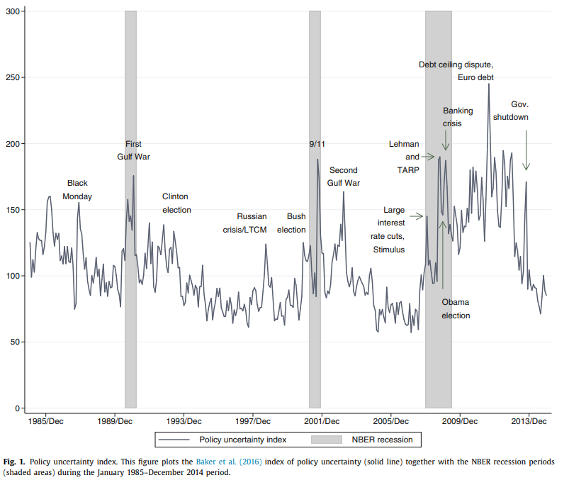
Notes:
Shaded area is recession. Line is the uncertainty index. See how they correlate

Slide 13
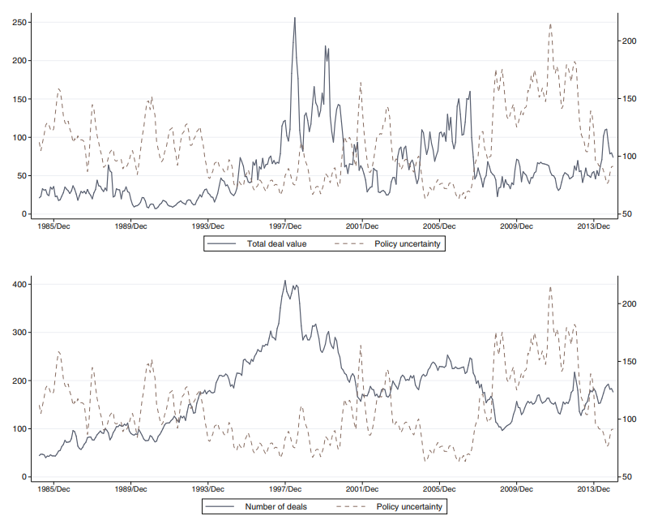
Notes:
TOP GRAPH: Deal value vs policy uncertainty
BOTTOM GRAPH:
Number of deals vs policy uncertainty

Slide 14
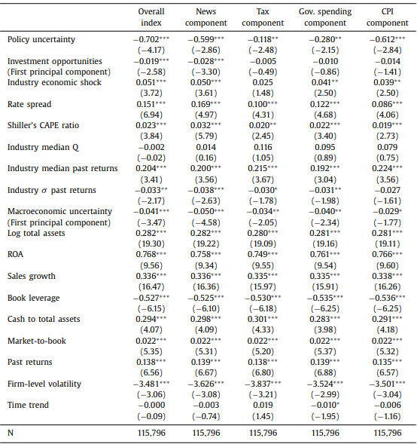
Table 3
Notes:
DEPENDENT VARIABLE IS ACQUISITION LIKELIHOOD
POLICY UNCERTAINTY NEGATIVELY IMPACTS ACQUISITION LIKELIHOOD
Table 3: Policy Uncertainty and Acquisition Likelihood A one standard deviation increase in policy uncertainty decreases the likelihood of a merger by 1.64%, which corresponds to an 11.74% relative decrease. Each component of the policy uncertainty Index (news, tax, government spending, CPI) negatively impacts merger activity. The results in Table 3 also reveal that each of the four components of the BBD policy uncertainty index contributes to the negative relation between policy uncertainty and M&A activity. Converting our point estimates to marginal effects, a one standard deviation increase in the news, tax, government spending, and CPI components is associated with a 9.82%, 10.11%, 7.16% and 9.98% decrease

Slide 15
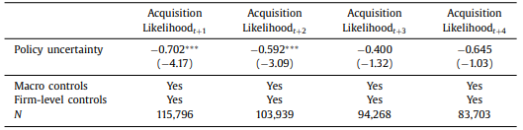
Table 4
Notes:
EFFECT IS DELAYED OVER TIME. ONLY T+1 and 2 Table 4: Policy Uncertainty and Delayed M&A Activity Policy uncertainty’s effect diminishes over time, showing a significant negative impact on acquisition likelihood in year t+1, but less so in t+3 and t+4.

Slide 16
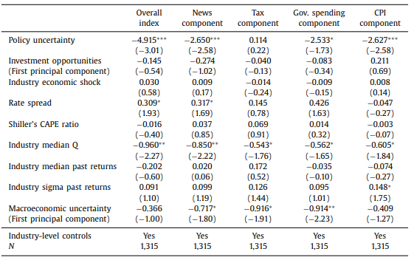
Table 5 – Policy Uncertainty and Merger Waves
Notes:
MORE UNCERTAINTY LEADS TO LESS MERGER WAVES. our dependent variable is now an indicator for the start of a merger wave within an industry, and we replace firm-level control variables with industry averages
Our results suggest that merger waves are less likely to begin in periods of high policy uncertainty.
a one standard deviation increase in the overall BBD policy uncertainty index (from its mean) corresponds to a 4.17% decrease in the likelihood of a wave commencing within the average industry. This represents an economically meaningful impact given that the start of merger waves occurs in our sample with 7.53% likelihood.

Slide 17
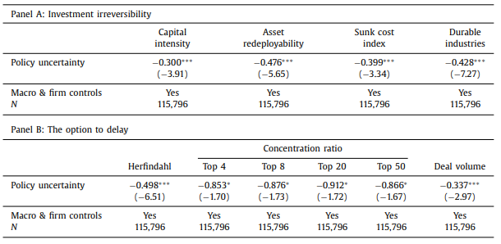
Table 6 – Investment Irreversibility and Target Competition
Notes:
firms are less likely to acquire targets that represent irreversible investments when policy uncertainty is high The results in Panel A of Table 6 show how investment irreversibility interacts with the relation between policy uncertainty and M&A activity.
Consistent with our predictions, across our four different measures of target irreversibility, we find that firms are less likely to acquire targets that represent irreversible investments when policy uncertainty is high Panel B of Table 6 shows that, as policy uncertainty increases, targets are less likely to come from oligopolistic industries with high concentration or low deal volume. Industry concentration and deal volume should be related to the likelihood of strategic actions from competitors (such as competing bids for the target or its peers),

Slide 18
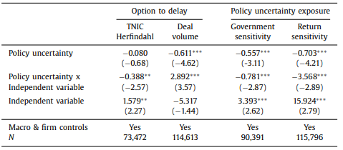
Table 7 – Acquirer Competition and Policy Uncertainty Exposure
Notes:
Effect is weaker for firms operating in more competitive industries
We test if the effect of policy uncertainty on M&As is weaker if the acquirer operates in a more competitive (less concentrated) industry or if many other firms in the same industry are engaging in acquisitions, thereby reducing a bidder’s ability to delay the deal.
Results reported in Table 7 suggest that—consistent the predictions of Grenadier (2002)—the relation between policy uncertainty and the likelihood of announcing an acquisition is weaker for firms operating in more competitive industries
Specifically, high policy uncertainty has a significantly more detrimental impact on the likelihood of announcing an acquisition for firms in more concentrated industries and in industries with low deal volume.20 To the extent that deals in oligopolistic industries are less costly to postpone (e.g., fear of a competitors acting strategically is lower), these results are consistent with the explanation that policy uncertainty decreases merger announcements primarily by increasing the value of the option to delay

Slide 19
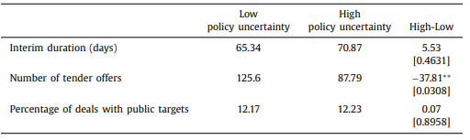
Table 8 - Policy Uncertainty and Interim Risk
Notes:
In Table 8 we test if policy uncertainty operates primarily through the interim risk channel. We split our sample into high (above median) and low (below median) policy uncertainty periods and compare variables correlated with actual and expected interim risk.
these tests reveal no evidence that an increase in expected firm-level interim risk drives the relation between policy uncertainty and M&A activity.
Interim risk refers to the uncertainty or potential changes in a transaction's conditions during the time between when a deal is announced and when it is completed.

Slide 20
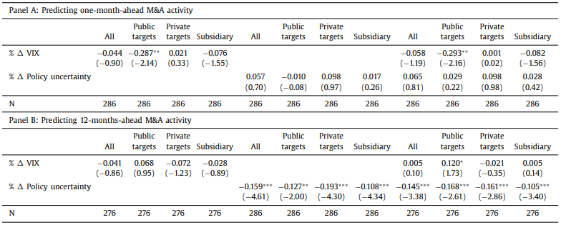
Table 9 – Policy Uncertainty Versus Market-Wide Volatility
Notes:
VIX = only public targets in short term.
POLICY = all targets in long term The results highlight that VIX affects short-term M&A activity, while policy uncertainty influences longer-term M&A decisions, suggesting that VIX impacts short-term risks (e.g., the seller’s put option), while policy uncertainty impacts longer-term decision-making (e.g., the option to delay).

Slide 21
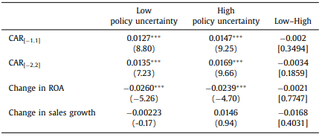
Table 10 – Policy Uncertainty and Deal Quality
Notes:
NO DIFFERENCE IN RETURNS for periods of high or low uncertainty around acquisition announcements.
In Table 10 we present averages of proxies for value creation, operating performance, and sales growth for periods of low versus high policy uncertainty. We split the sample along the median policy uncertainty value throughout our time period. We then calculate three- and five-day cumulative abnormal returns (CARs) around acquisition announcements as the buy and hold return on the bidder’s stock net the buy and hold return on the value-weighted CRSP index. The results reveal no evidence of a meaningful difference between announcement CARs for periods of high and low policy uncertainty

Slide 22
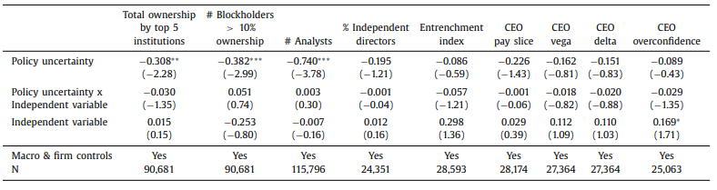
Table 11 – Policy Uncertainty, Corporate Governance, CEO Characteristics
Notes:
The effect does not depend on acquirers’ corporate governance qualities, or CEO qualities.
The results presented in the first six columns of Table 11 show that these interactions are not statistically significant, which indicates that the effect of policy uncertainty on merger activity does not depend on acquirers’ corporate governance quality (i.e., their ability to engage in empire-building)
The results, reported in the last three columns of Table 11 show that the interactions between our three proxies and the BBD index are all statistically insignificant. This finding suggests that the effect of policy uncertainty on merger activity is not meaningfully related to managers’ incentive or willingness to engage in empire-building. Overall, the tests described in this section show no evidence that policy uncertainty affects M&A activity through an empire-building channel.

Slide 23
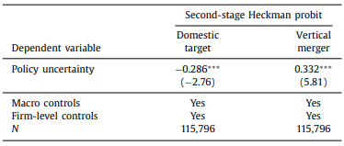
Table 12 – Policy Uncertainty and Risk Management
Notes:
Heckman model is used to correct for selection bias in cases where the sample is not randomly selected.
, imply that the likelihood of vertical mergers increases as policy uncertainty increases. These findings are consistent with firms seeking to reduce firm level uncertainty during times of high policy uncertainty through vertical integration.
The are also more likely to search for a foreign target, to avoid domestic policy issues. Our results show that the likelihood of acquiring domestically versus abroad decreases as policy uncertainty increases. This finding is consistent with acquiring firms preferring to reduce their exposure to domestic policy risks by looking abroad for acquisitions.
Our results, presented in the second column of Table 12, imply that the likelihood of vertical mergers increases as policy uncertainty increases. These findings are consistent with firms seeking to reduce firmlevel uncertainty during times of high policy uncertainty through vertical integration. Hence, the results in this section suggest that operational hedging plays a role in how policy uncertainty affects certain types of merger decisions. Nevertheless, it is important to recognize that this risk management channel cannot be the primary mechanism through which policy uncertainty affects M&A ac

Slide 24
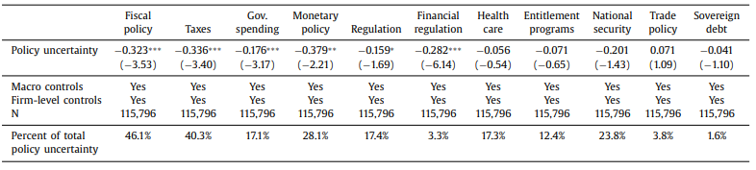
Table 13 – Which Policies Matter Most?
Notes:
LIKE TABLE 3, BUT DIFFERENT ASPECTS OF THE POLICY INDEX. MOSTLY ONLY FISCAL POLICY MATTERS.
In Table 13 we report logistic regressions of acquisition likelihood on policy uncertainty and controls. These tests are analogous to our baseline specifications from Table 3. Different from Table 3, however, each column uses a different category-specific policy uncertainty index. The first four columns reveal that the uncertainty related to fiscal policy (both taxes and government spending) and monetary policy are meaningfully negatively related to future M&A activity

Slide 25
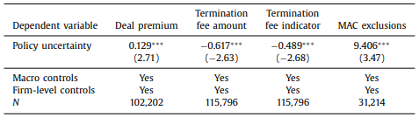
Table 14 - Deal Characteristics and Policy Uncertainty
Notes:
Increased Deal Premiums: Higher policy uncertainty leads to significantly larger deal premiums, with a coefficient of 0.129. This indicates that targets gain greater negotiating power, allowing them to secure higher payments during periods of high uncertainty.
Lower Termination Fees: Policy uncertainty reduces both the amount and likelihood of target termination fees (coefficients of -0.617 and -0.489 respectively). This suggests that targets negotiate fewer or smaller exit fees, likely reflecting their stronger position during negotiations.
More MAC Exclusions: Material Adverse Clause (MAC) exclusions, which limit an acquirer's ability to abandon a deal, increase with policy uncertainty (coefficient of 9.406). This implies that targets secure greater protections, reducing the chances for acquirers to walk away from deals.
A MAC exclusion refers to specific contractual terms in a merger or acquisition agreement that limit the scenarios in which the acquirer can terminate the deal due to significant negative changes in the target's situation (e.g., financial performance or regulatory issues). These exclusions effectively remove the acquirer's option to back out of the deal under certain adverse conditions, making it harder for the acquirer to abandon the transaction.
, in Table 14 we model the relation between policy uncertainty and deal characteristics using two-stage Heckman models and present coefficients associated with policy uncertainty for second-stage models.
Column 1 in Table 14 shows that acquirers pay significantly higher premiums for targets as policy uncertainty increases
In the second and third columns of Table 14, we find that policy uncertainty is negatively associated with the amount of and likelihood of having a target termination fee, again consistent with increased negotiating power on the part of the target.
we find that the number of MAC exclusions increases with policy uncertainty, consistent with acquirers having fewer scenarios under which they can back out of the deal

Slide 26
Conclusion
Significant Negative Influence: Policy uncertainty acts as a major friction in the M&A environment, reducing overall deal value and volume. A one standard deviation increase in policy uncertainty leads to:
6.6% decrease in aggregate M&A deal value.
3.9% reduction in the number of deals.
4.17% lower likelihood of initiating a merger wave.
Firm-Level Effects: At the firm level, policy uncertainty reduces merger likelihood by 1.1 percentage points, equivalent to an 8.9% decrease in the unconditional probability of announcing a merger.

Slide 27
Conclusion
Permanent Impact: The lack of mean reversion implies that lost acquisitions during periods of high policy uncertainty are not delayed but permanently forgone.
Broader Implications: The findings emphasize the critical role that policy stability plays in capital allocation, suggesting that reducing policy uncertainty could foster more efficient capital markets through increased M&A activity.

